Slide 1
Healthcare-elderly

Slide 2
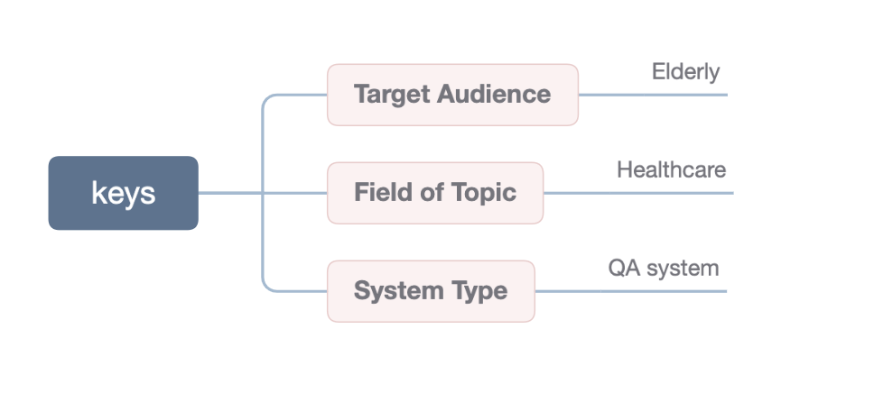
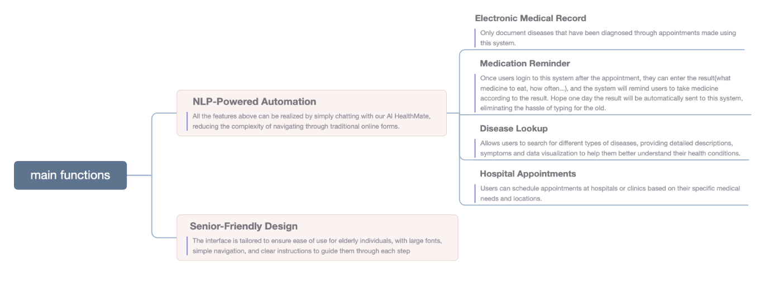
BACKGROUND

Slide 3
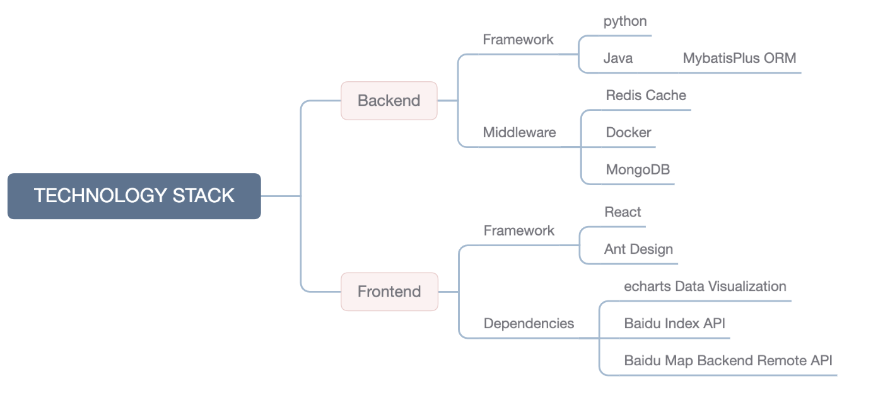
TECHNOLOGY STACK

Slide 4
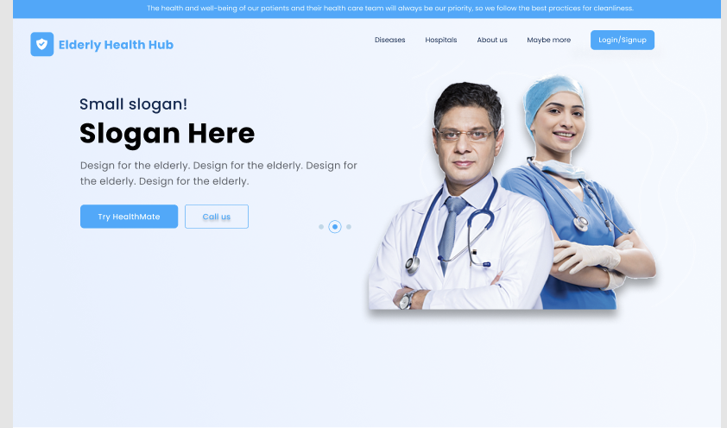
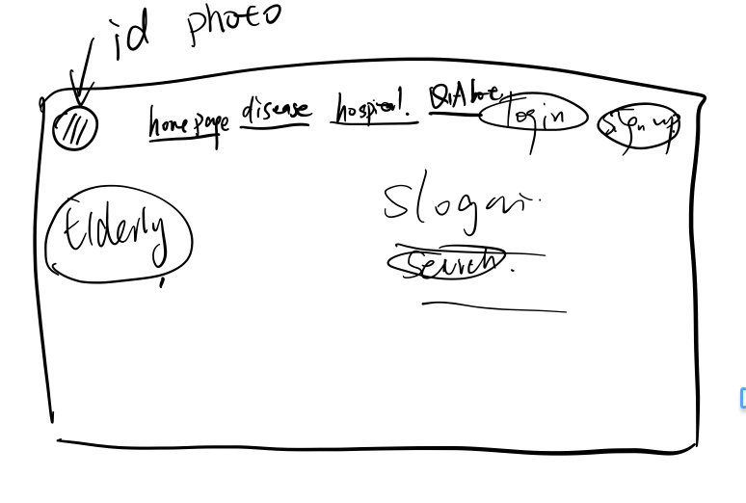

Slide 5
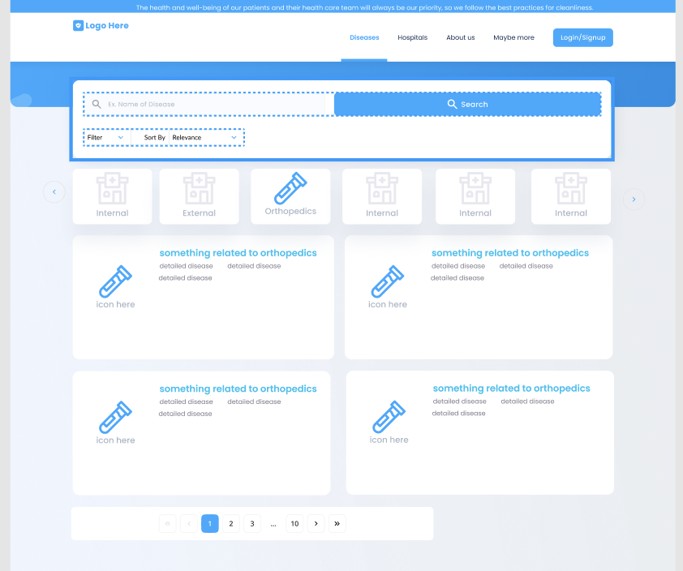
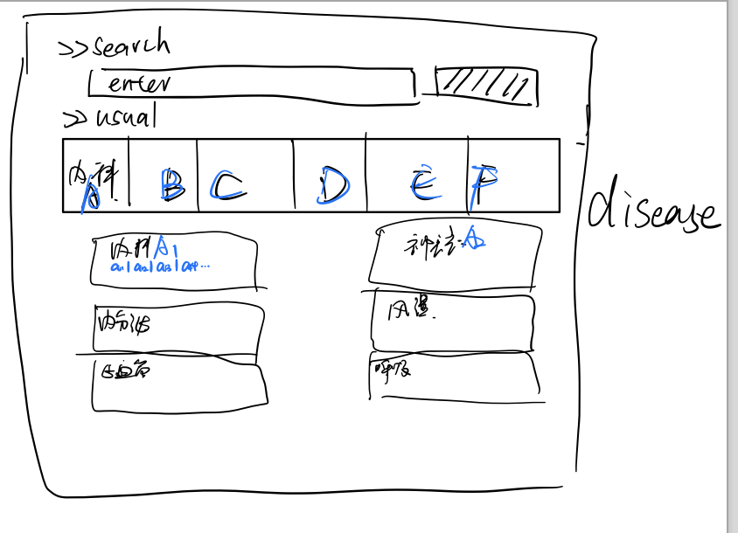
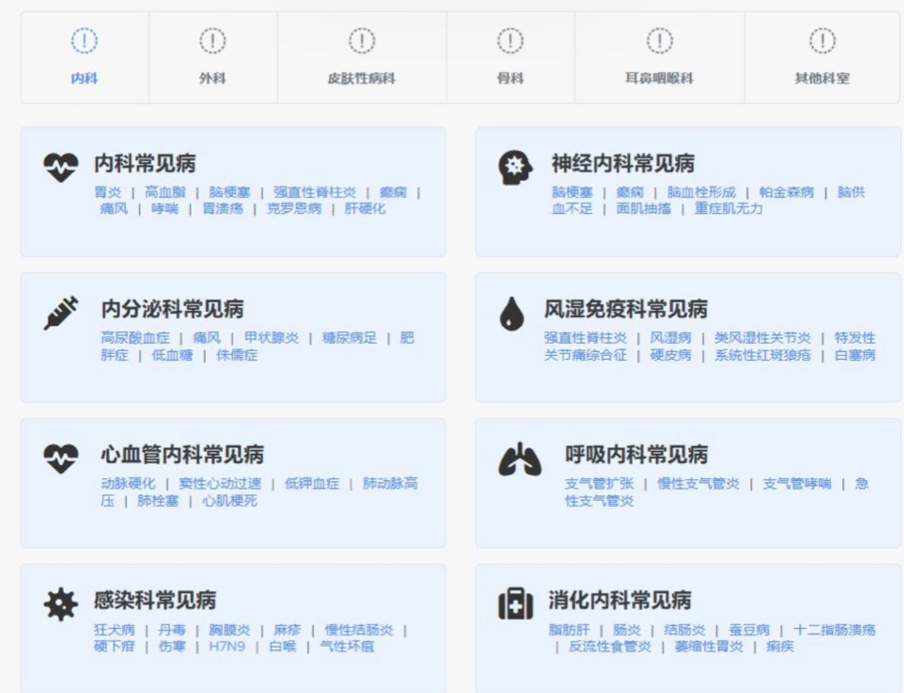

Slide 6
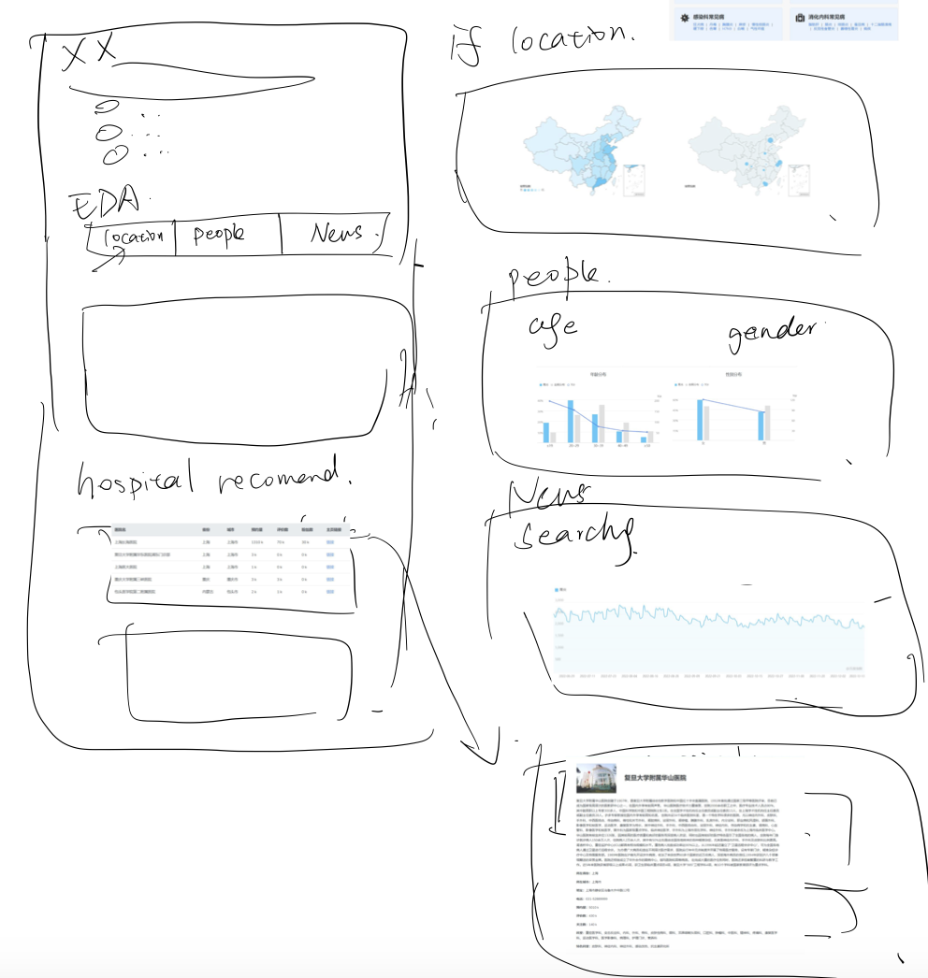
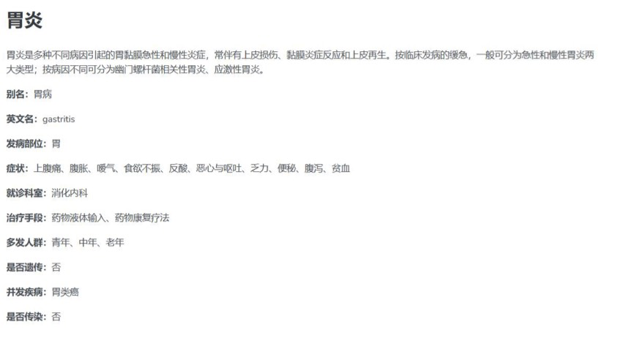
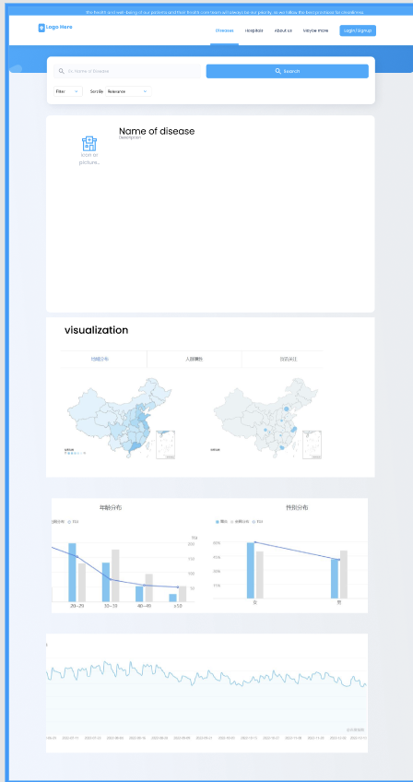

Slide 7
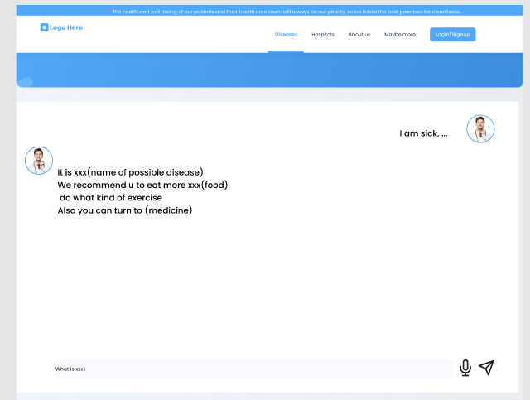
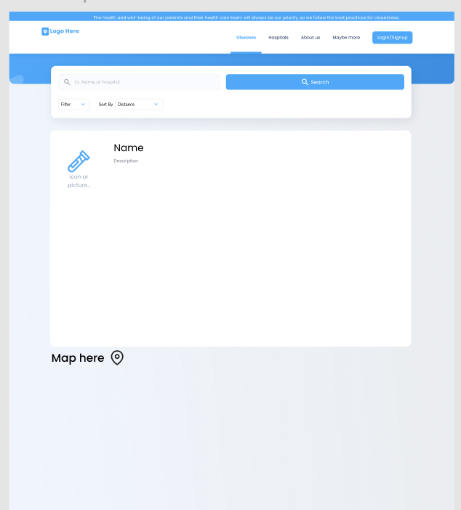
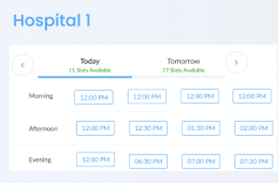
Ask questions about the disease:
I am sick, …
It is xxx(name of possible disease)
We recommend u to eat more xxx(food) do what kind of exercise
Also you can turn to (medicine)
I want to go to the hospital
Of course, here are the hospital and clinic we recommend
id | hospital | action
 |  | [detail][make appointment]
also, we can mke a list of the user‘s basic info，and give them of the possible information need to fill in…

Slide 8
Offer users of the medication reminder
Offer users of the medication reminder
Hi Linda, I have noticed that u go to the hospital, is there any deletion or addition of medications recommended by doctors
Hi Linda, remember to take xxx(medicine) to quicker cure stomach problems!
Xxx days left😊
Feel free to ask me any other questions!
id | medicine | left_days
1. | xxxx | 3
2. | xxxx | 4
id | medicine | Days
1. | xxxx | 3
2. | xxxx | 4
Add xxx, delete xxx
The day of xx is xxx
Today, i feel better, and I want to do some exercise
Of course! Here are the final list of …
id | medicine | Days
1. | xxxx | 4
2. | xxxx | 4
Of course, here are some exercises that u can do: 1. swimming🏊
…

Slide 9
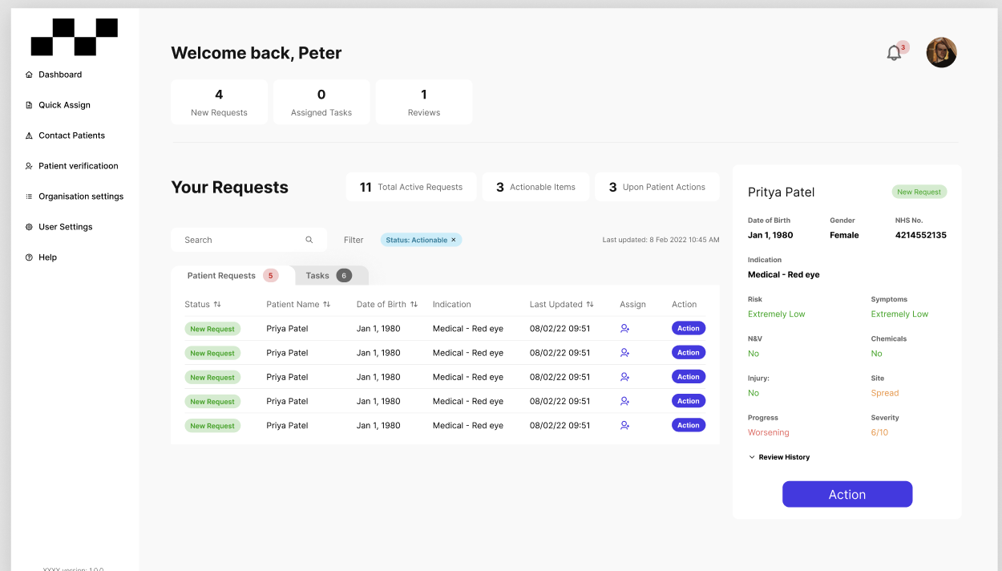

Slide 10
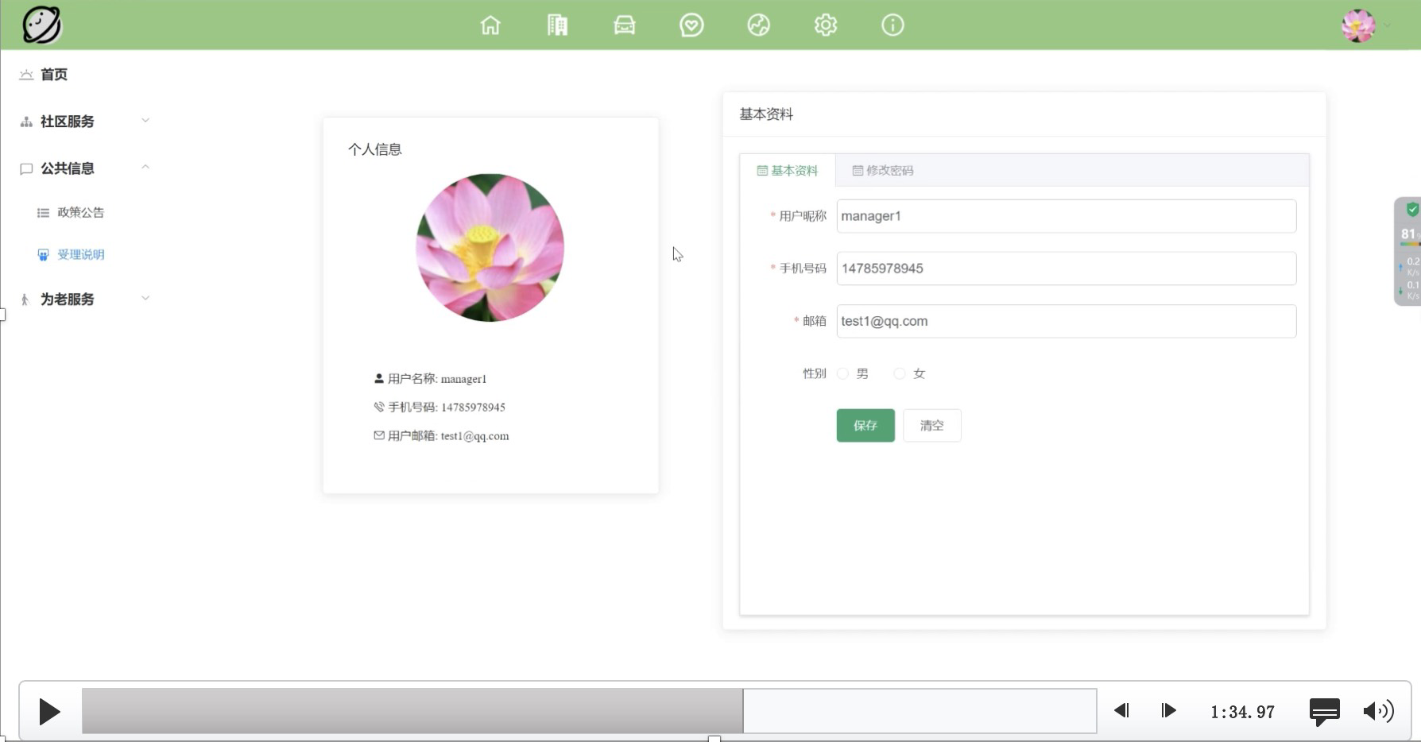
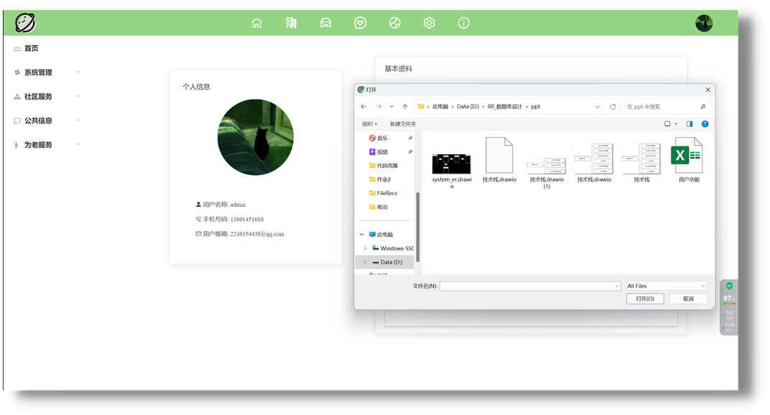

Slide 11
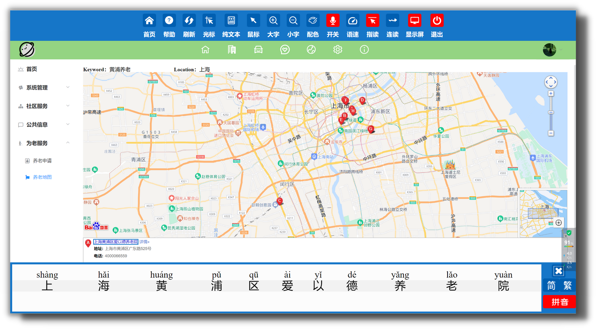

Slide 12
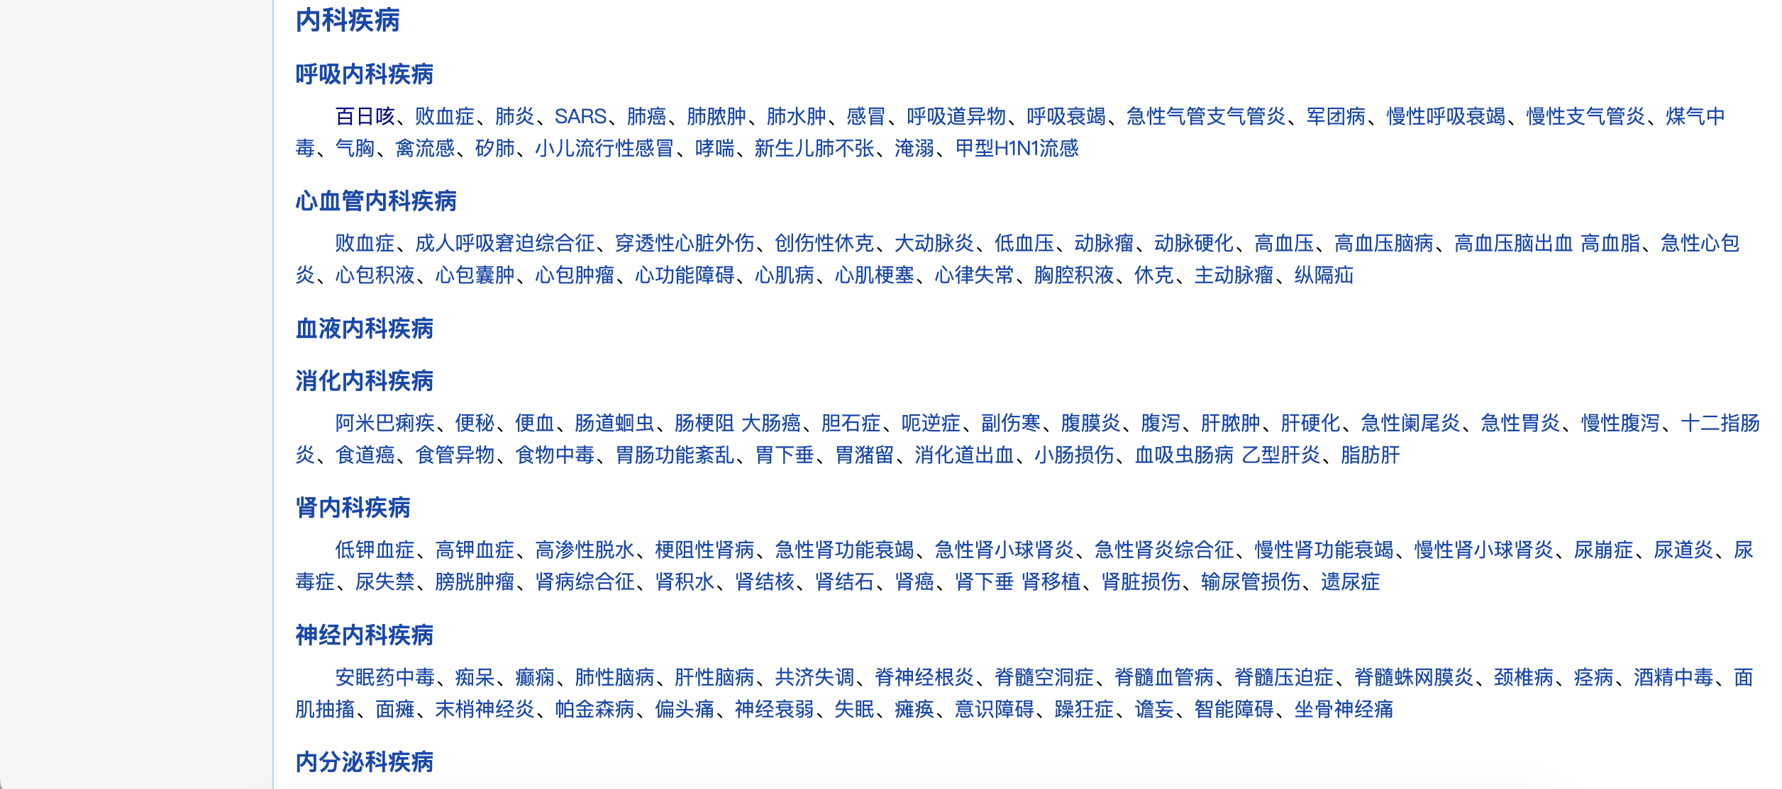
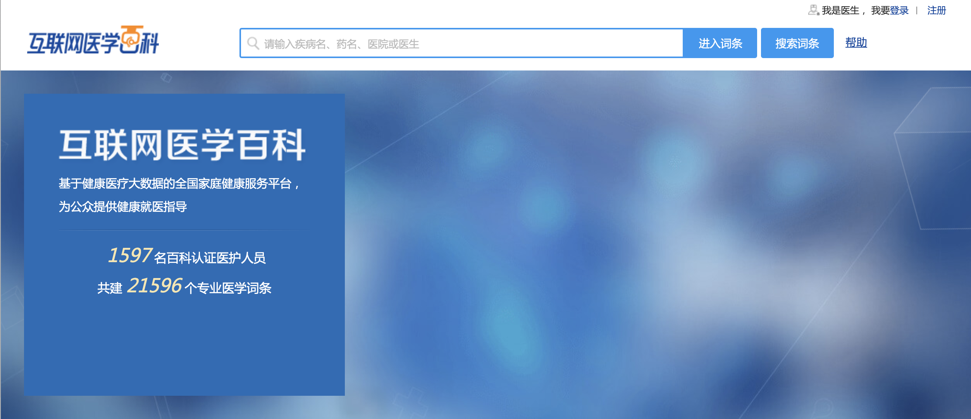
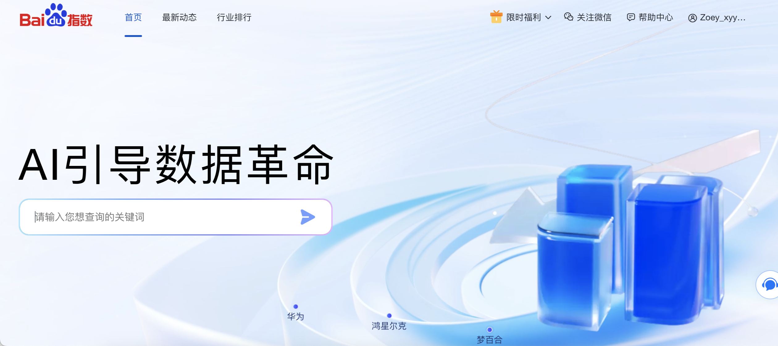
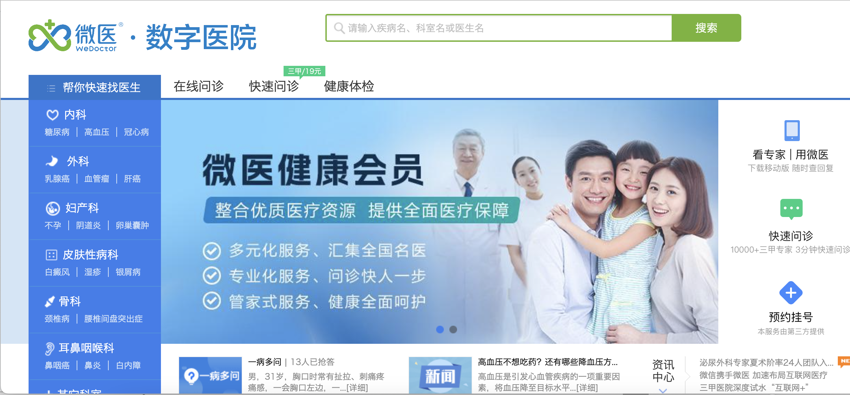
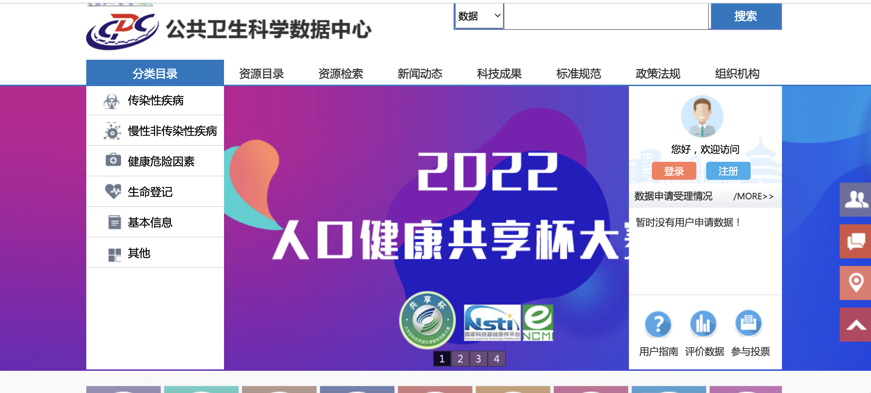

Slide 13
The first question is whether it is necessary to use RAG, or just directly use RAG.
Another question is, regarding our feature points, what are the unreasonable aspects according to the teacher, or are there any areas that need to be added?
Is it possible to use data scraped in Chinese?

Slide 14
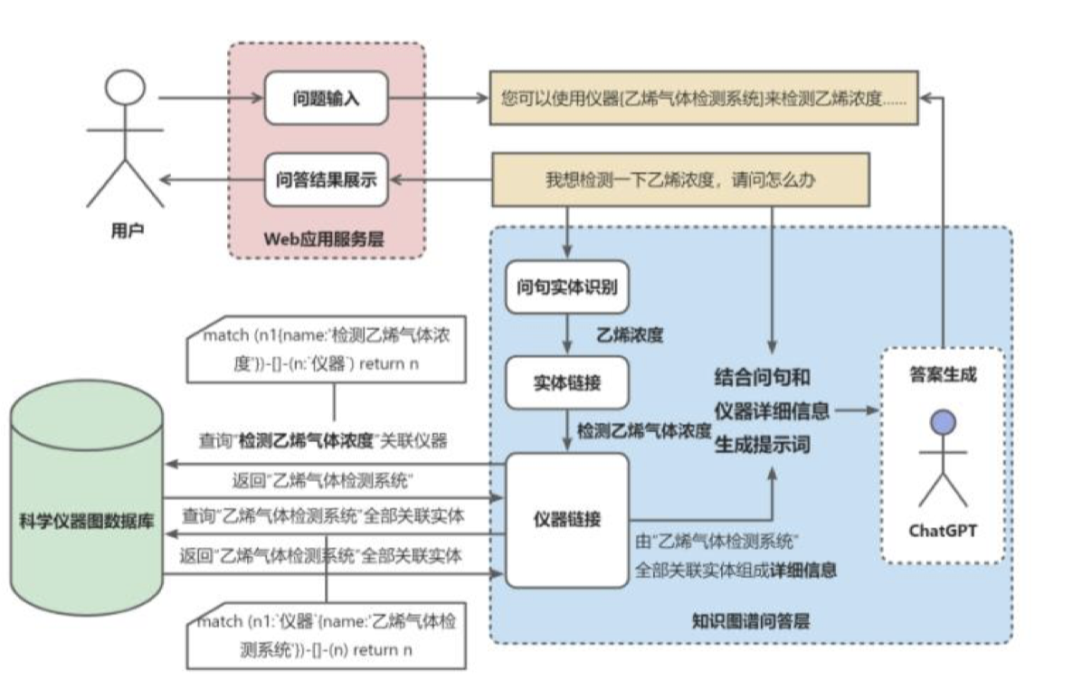
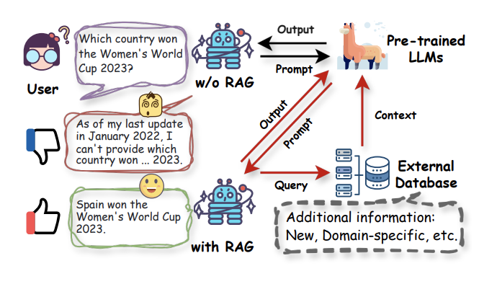
Traditional knowledge QA system
Rag + LLM(detailed+reliable in biology)

Slide 15
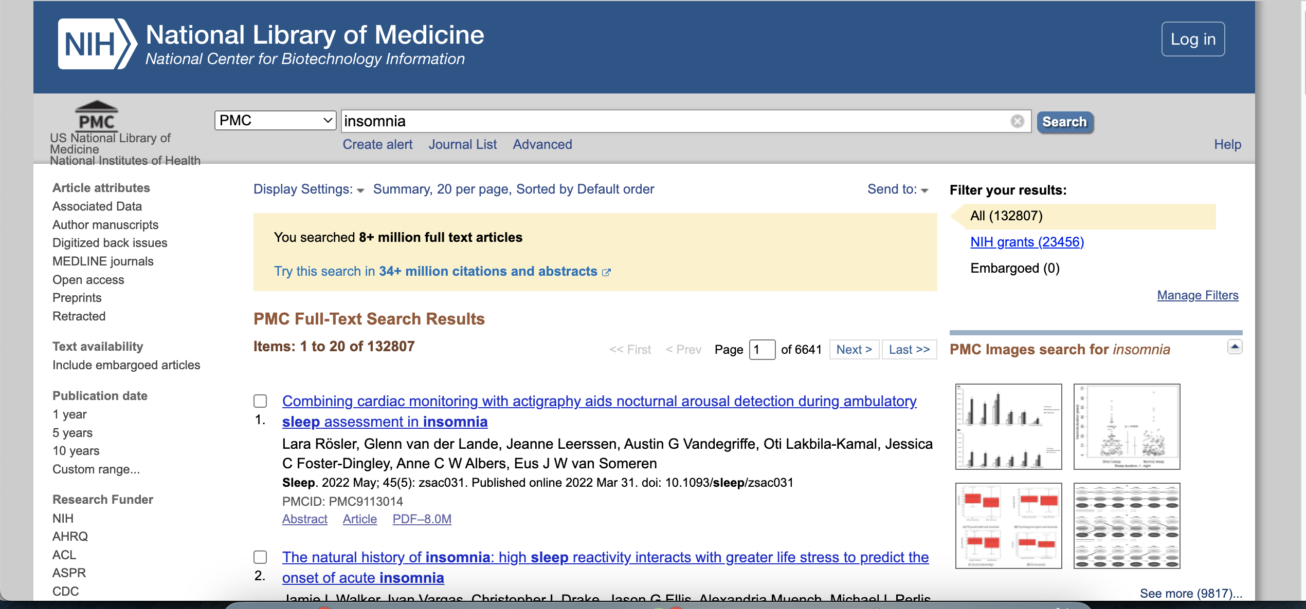
Traditional knowledge QA system
PWC
Rag + LLM

